Slide 1
DASH QUEST
- Bharani Kadamban S (MBT8)

Slide 2
In this report , we could see the report of Amazon Sales analysis
Home PAGE
Report 1
REPORT 2

Slide 3
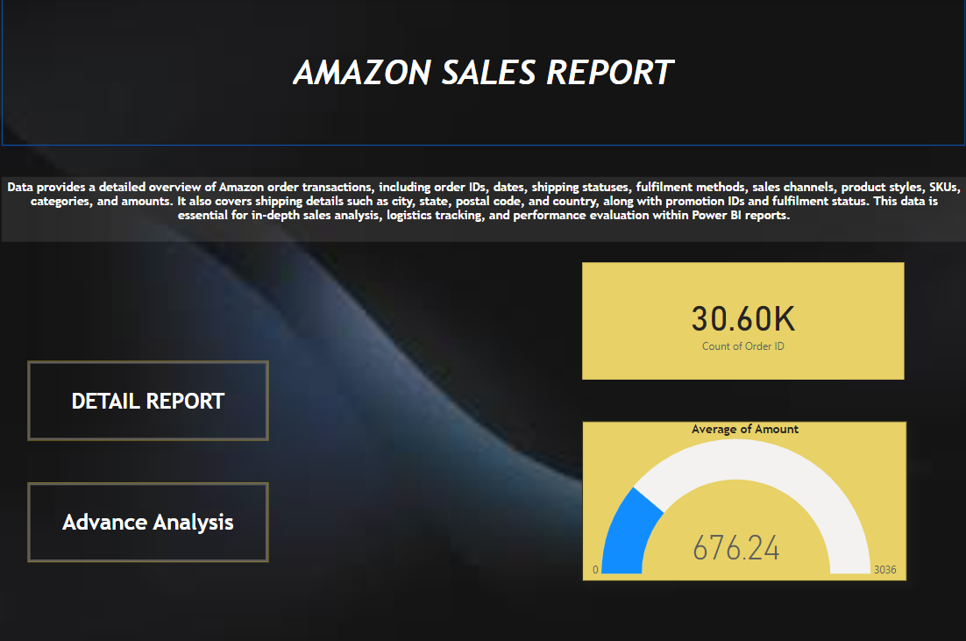
Home Page
In this home page ,we can see how many orders have been placed and average amount of sales totally happened
30.60k products have been placed
676.24 rupees is the average amount of sales

Slide 4
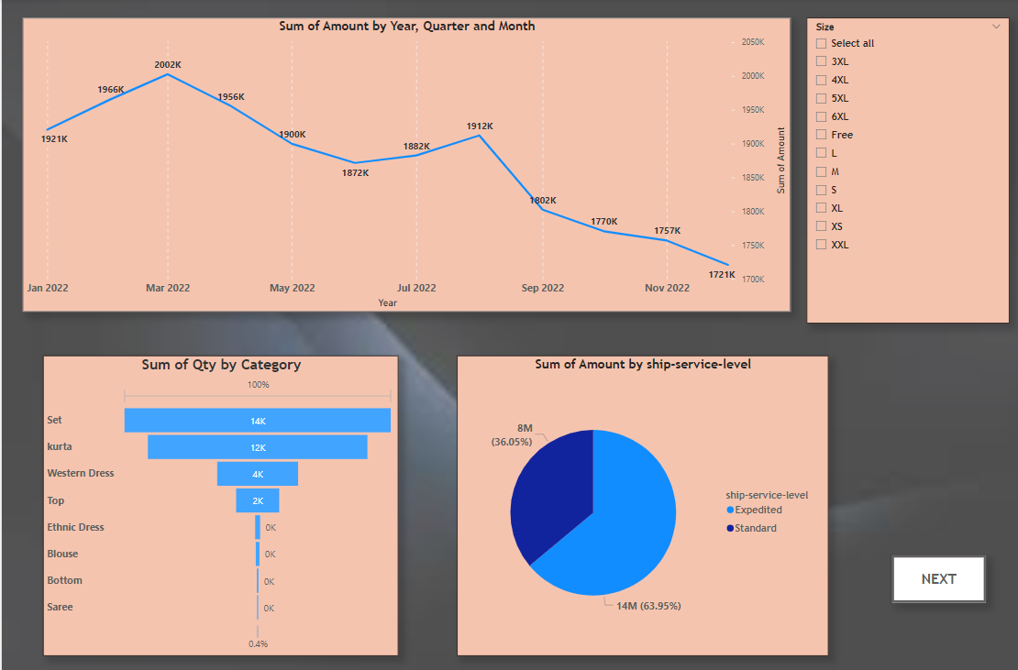
Report Page 1
Use Line chart to get the total sales over the year
Total quantity for each products in category wise to know the how much the product quantities has been sold
Pie chart depicts the total amount returned from standard and Expedited

Slide 5
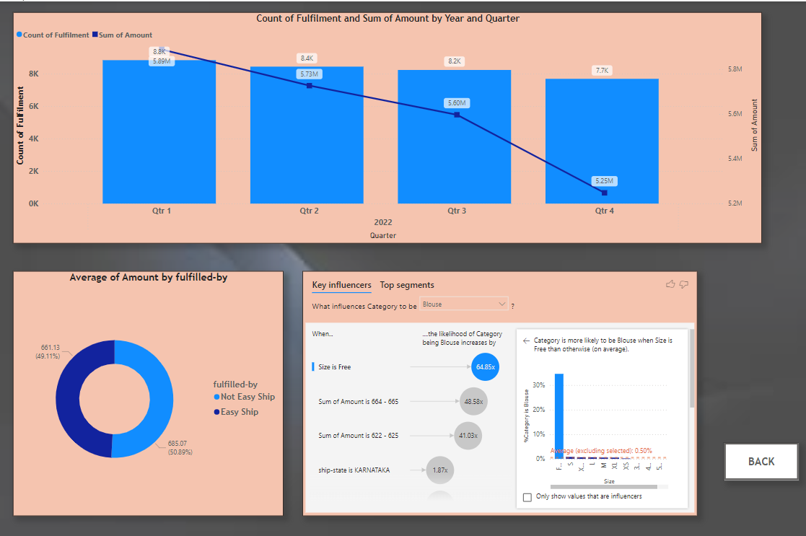
Report Page 2
Bar chart represents the count of fulfilment and total amount over the quarter of the year. From this chart , we come to know that profit for each quarter
Donut chart provides us the average sales done through Easy ship and Not easy shipping
Key Influencers ensures that the overall revenue of Amazon products

Slide 6
END

